Slide 1
CSE 460: VLSI Design
Lecture 5: Finite State Machines (part 3)

Slide 2
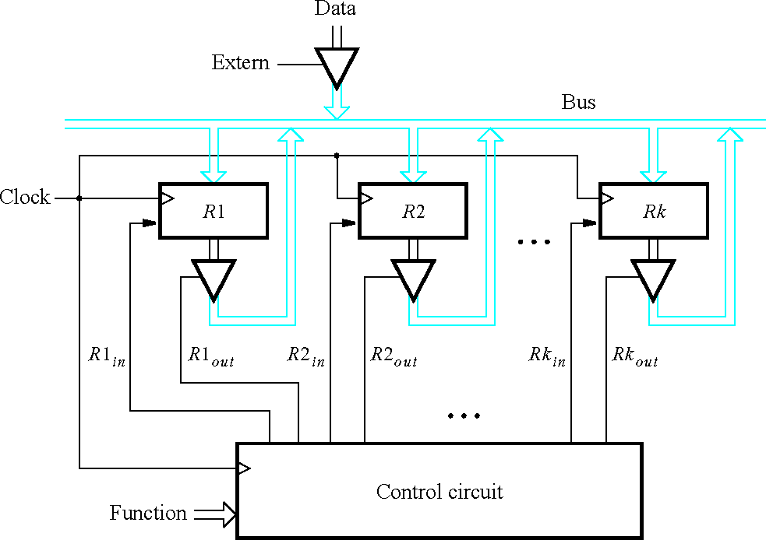
K registers connected with n-bit bus.
Example-2
Figure 7.55.
A digital system with k registers.

Slide 3
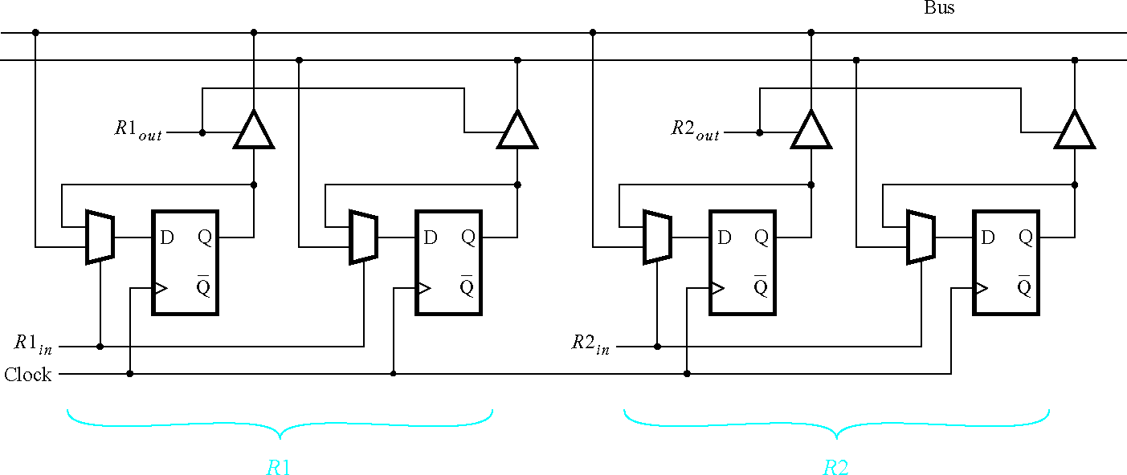
Figure 7.56.
Details for connecting registers to a bus.

Slide 4
^{R1}out R1_{in}
^{R2}out R2
w
Control circuit
in
^{R3}out R3_{in}
Done
Clock
Figure 8.10.
Signals needed in Example 8.1.

Slide 5
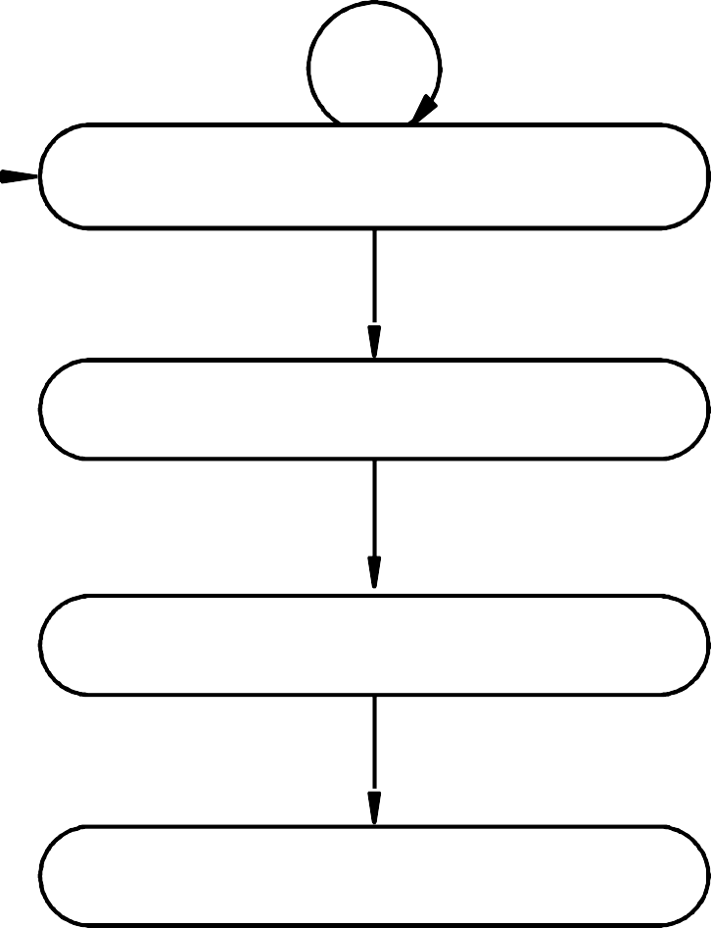
w = 0
A ⁄ No transfer
Reset
w = 1
B ⁄ R2_{out} = 1, R3_{in} = 1
w = 0
w = 1
C ⁄ R1_{out} = 1, R2_{in} = 1
w = 0
w = 1
w = 0
w = 1
D ⁄ R3_{out} = 1, R1_{in} = 1, Done = 1
Figure 8.11.
State diagram for Example 8.1.

Slide 6















Present state | Next |  |  | state |  | Outputs
 | w | = | 0 | w | = 1
A | A |  | B |  |  | 0 | 0 | 0 | 0 | 0 | 0 | 0
B | C |  | C |  |  | 0 | 0 | 1 | 0 | 0 | 1 | 0
C | D |  | D |  |  | 1 | 0 | 0 | 1 | 0 | 0 | 0
D | A |  | A |  |  | 0 | 1 | 0 | 0 | 1 | 0 | 1
Figure 8.12.
State table for Example 8.1.

Slide 7























Present state | Next | state | Outputs
00 | 00 | 0 1 | 0 | 0 | 0 | 0 | 0 | 0 | 0
01 | 10 | 1 0 | 0 | 0 | 1 | 0 | 0 | 1 | 0
10 | 11 | 1 1 | 1 | 0 | 0 | 1 | 0 | 0 | 0
11 | 00 | 0 0 | 0 | 1 | 0 | 0 | 1 | 0 | 1
A B C D
Figure 8.13.
State-assigned table for the sequential circuit in Figure 8.12.

Slide 8
y₂ y ₁
w
00 01 11 10
0
1
Y ₁ = wy ₁ + y₁ y₂
1
1
1
y₂ y ₁ w | 00 | 01 | 11 | 10
0 |  | 1 |  | 1
1 |  | 1 |  | 1
Y ₂ = y ₁ y ₂ + y₁ y₂
Figure 8.14.
Derivation of next-state expressions for the sequential circuit in Figure 8.13.

Slide 9
w
Y
y
R 1 _{in}
1
D Q
1
R 3
out
y₁
Clock
Q
Done
^{R 1} out
R 2 _{in}
Y ₂
y₂
D Q
y₂
Q
^{R 2} out
R 3 _{in}
Figure 8.15.
Final implementation of sequential circuit in Figure 8.13.

